Slide 1
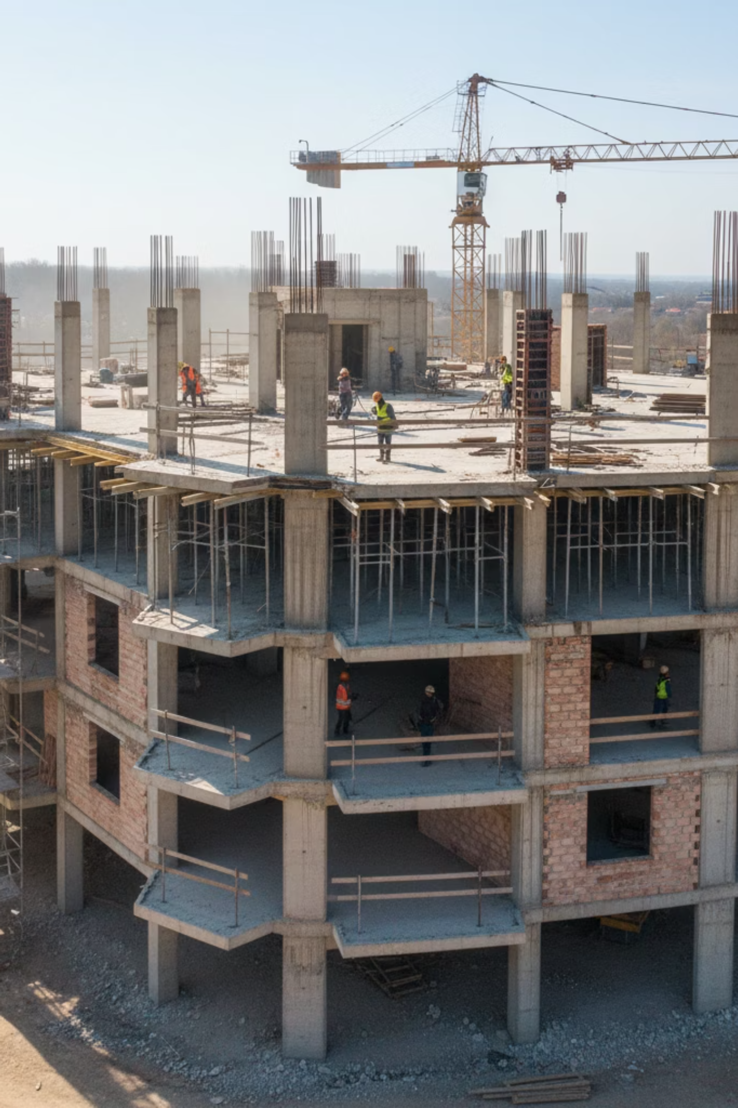
Tech Tappers(ICIH-54): Building the Future of Construction
AI-Powered BIM & Digital Twins to Eliminate Cost and Time Overruns

Slide 2
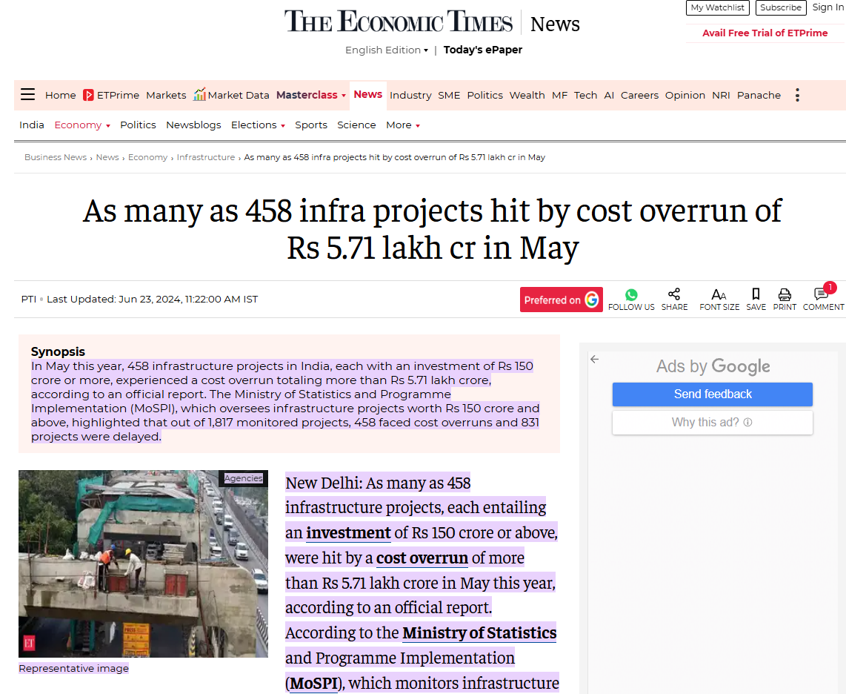

Slide 3



The $1.6 Trillion Problem
9 out of 10
Construction is chronically inefficient
The construction industry consistently faces significant cost and time overruns, creating massive inefficiencies across global infrastructure projects.
projects face cost overruns
Poor Coordination
Hidden Design Flaws
Budget Mismanagement
Creates delays and expensive rework between multiple teams and stakeholders.
Cause major changes during construction when discovered too late in the process.
Leads to massive cost escalation and material waste across project lifecycles.

Slide 4
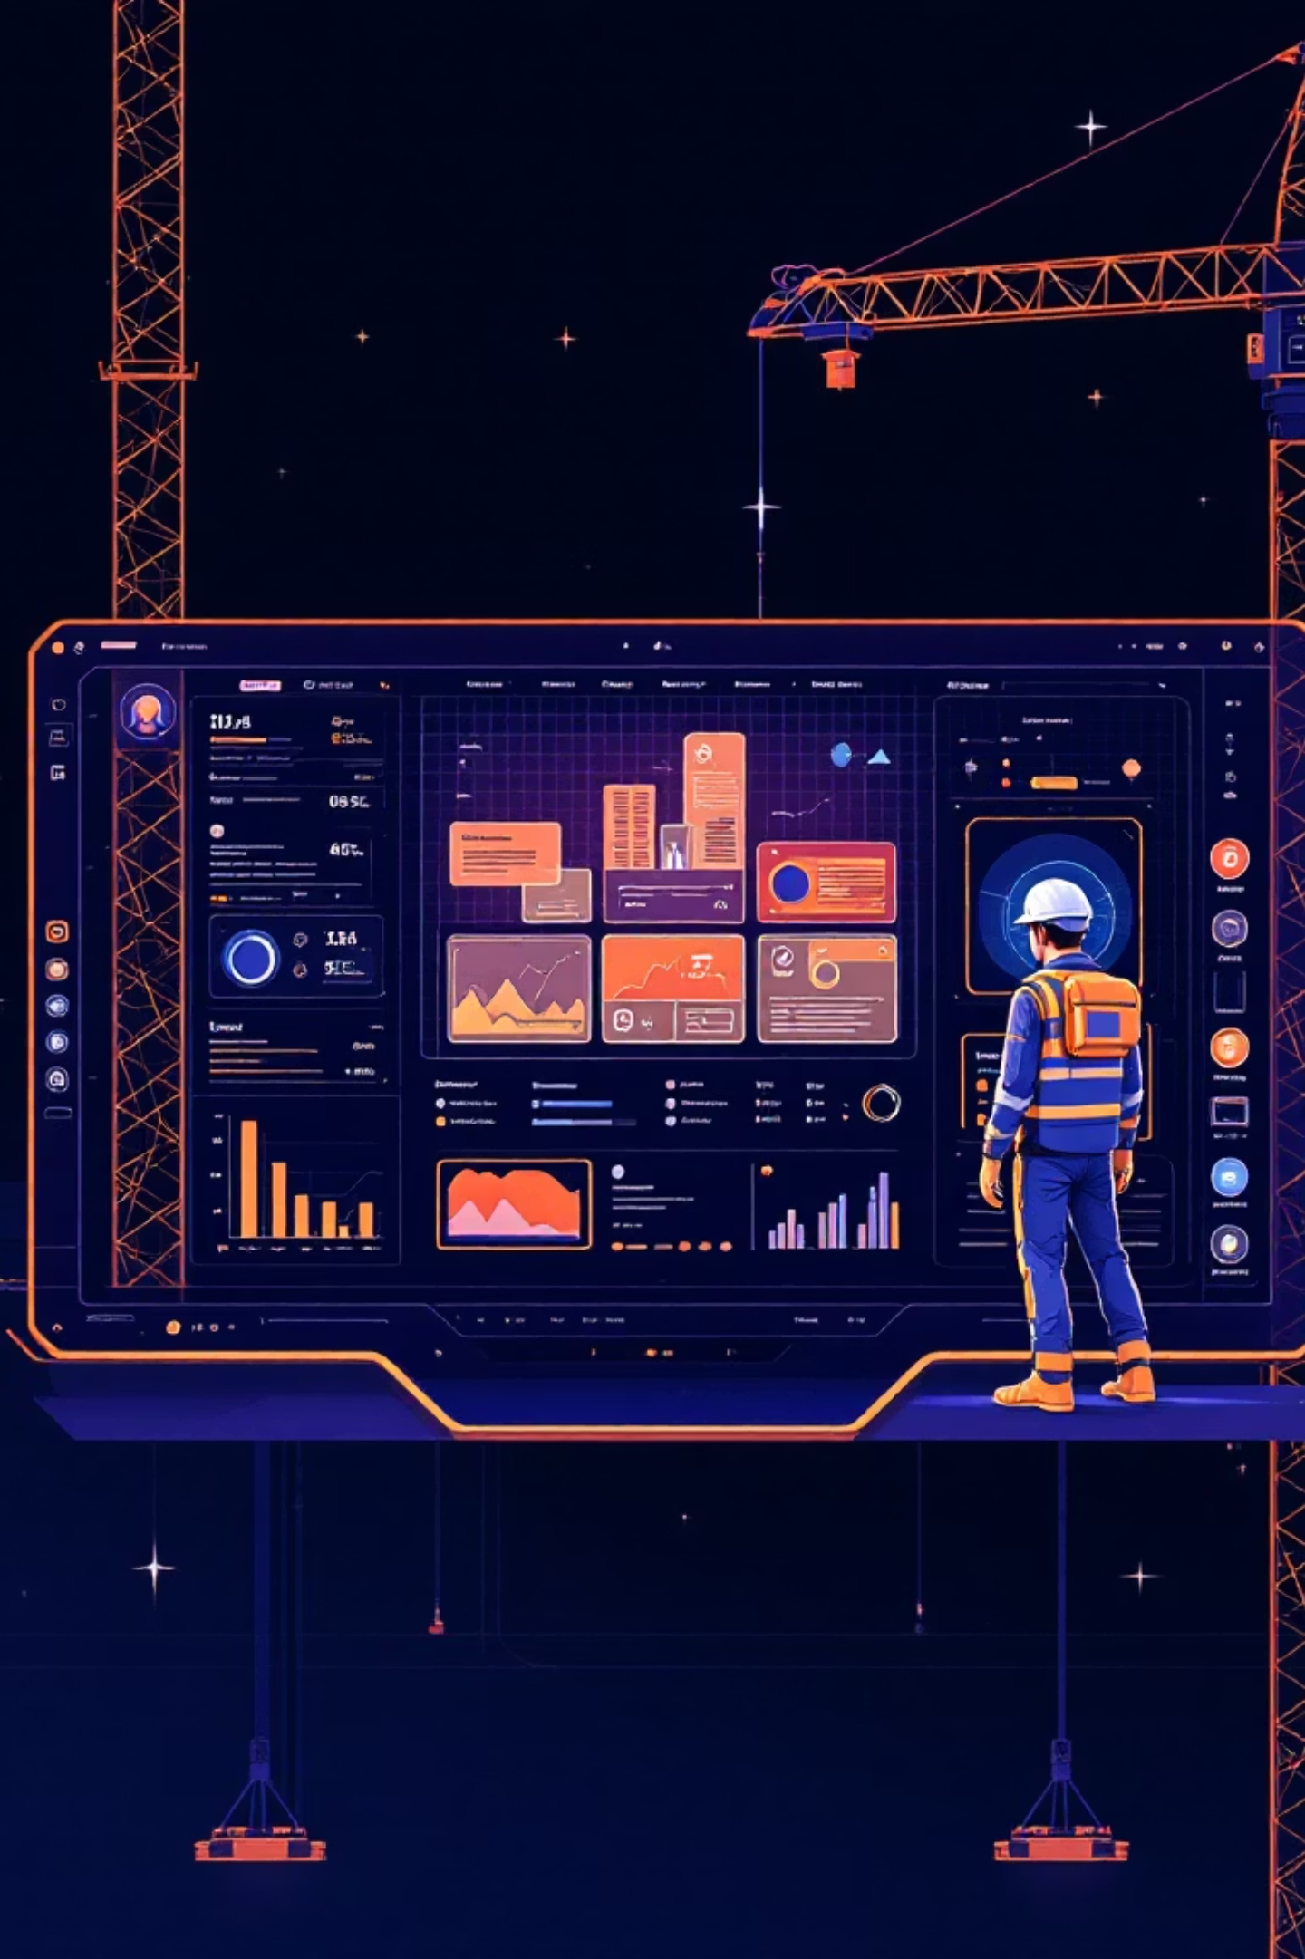
BIM Tool
Leveraging AI-powered BIM and Digital Twin technologies to bring intelligent automation to every phase of construction.
AI Design Validation
Automatically detect flaws during construction begins
Predictive Resource Planning
Optimize workforce and material allocation
Real-time Budget Control
Monitor costs and progress continuously
Project Monitoring
Track every step with alerts
Architect Independency
Removes dependency on the architect/builder

Slide 5
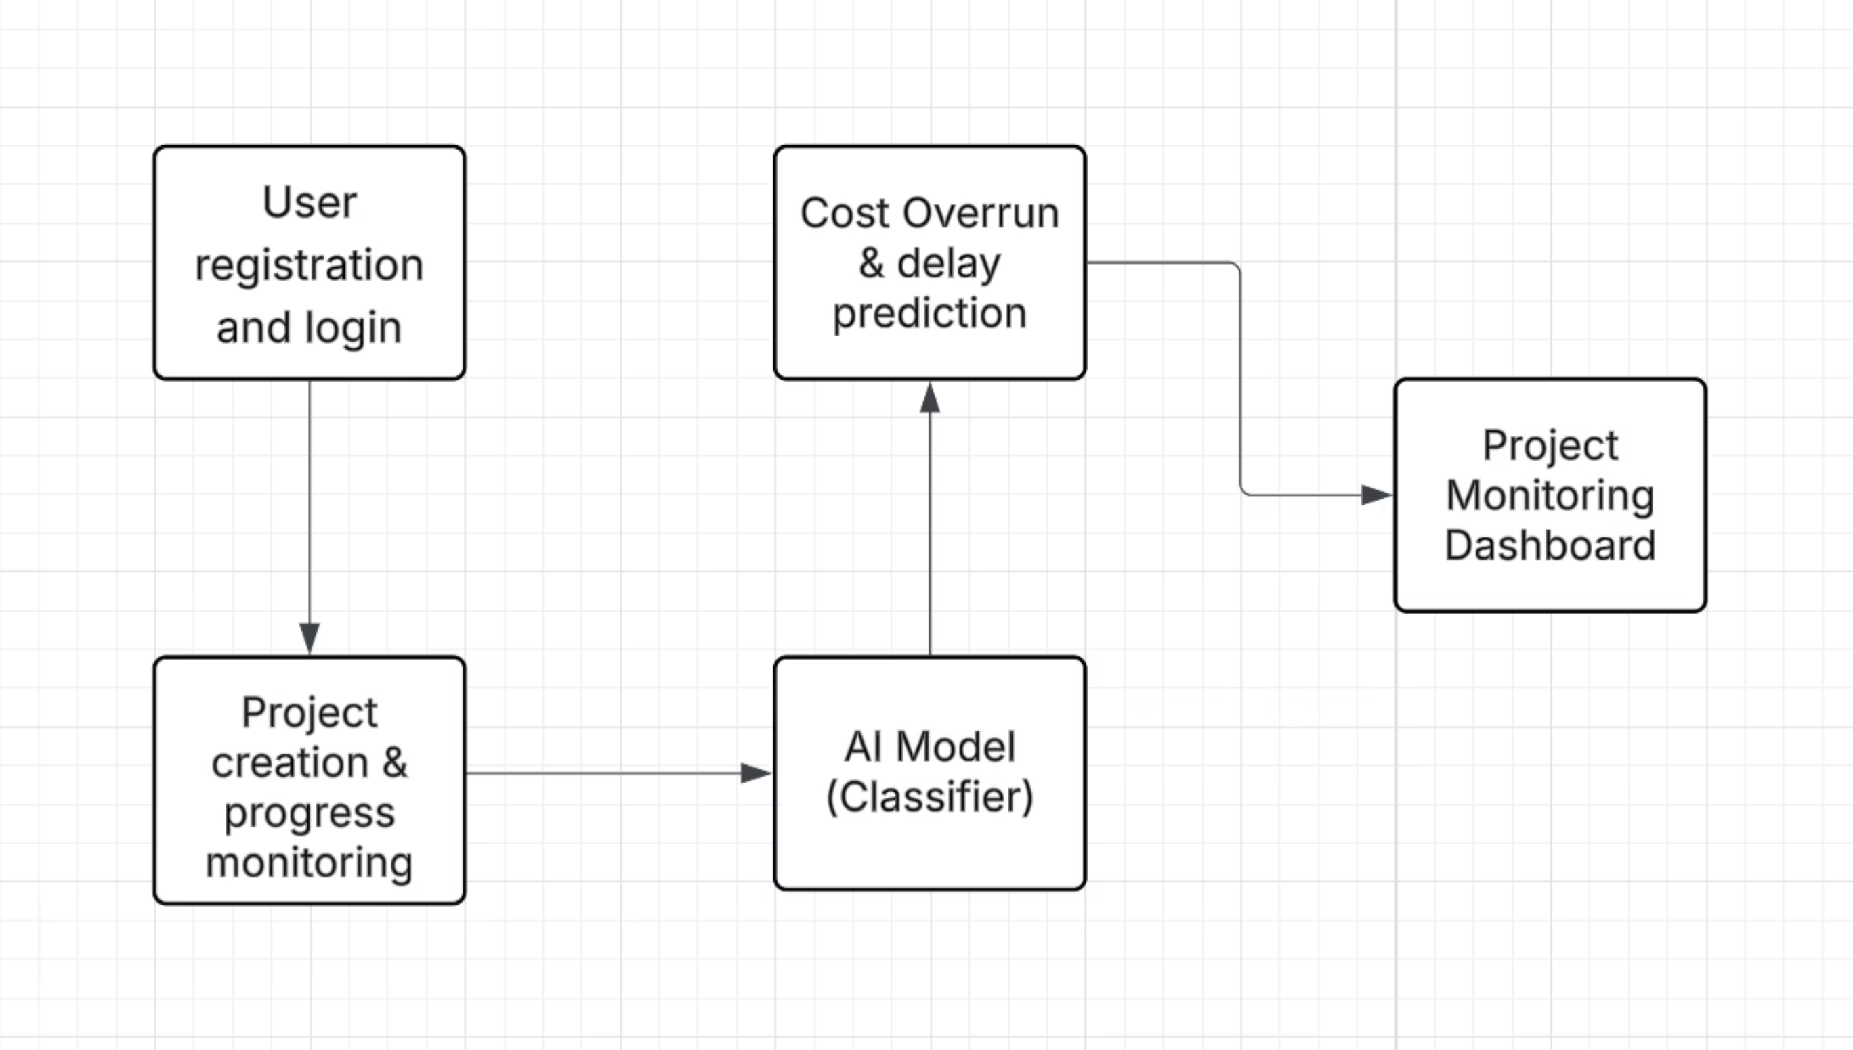
Data Flow Diagram

Slide 6




From Blueprint to Reality, Seamlessly
Data Input
AI/ML Engine
We gather BIM models, budgets, and project plans into our unified system.
Our algorithms analyze data to detect flaws, forecast needs, and identify risks.
Intelligent Analytics
Constant Sync
We generate actionable insights on role-based dashboards.
Digital Twin updates continuously, keeping digital and physical worlds aligned.

Slide 7

A Smarter Way to Build
1
AI Design Validation
Automated flaw detection and code compliance checks catch errors before they become costly problems.
2
Predictive Analytics
Accurate budget forecasting and timeline optimization using historical data and machine learning.
3
Interactive 3D Visualization
Browser-based BIM models with measurement tools for immersive project exploration.
4
Role-Based Dashboards
Customized views for clients, builders, and managers with relevant insights for each stakeholder.

Slide 8



A Win-Win for Everyone
Our platform delivers measurable value to every stakeholder in the construction ecosystem.
For Clients
For Builders
For Managers
Total transparency
Reduced rework
Data-driven decisions
Quality assurance
Enhanced client trust
Risk mitigation
Accurate budgets
Competitive edge
Optimized resources

Slide 9
Tech Stack
Frontend
React/Next.js
Backend
Node.js
Database
MongoDB
AI/ML
TensorFlow/PyTorch
Visualization
Three.js
Cloud
Atlas

Slide 10
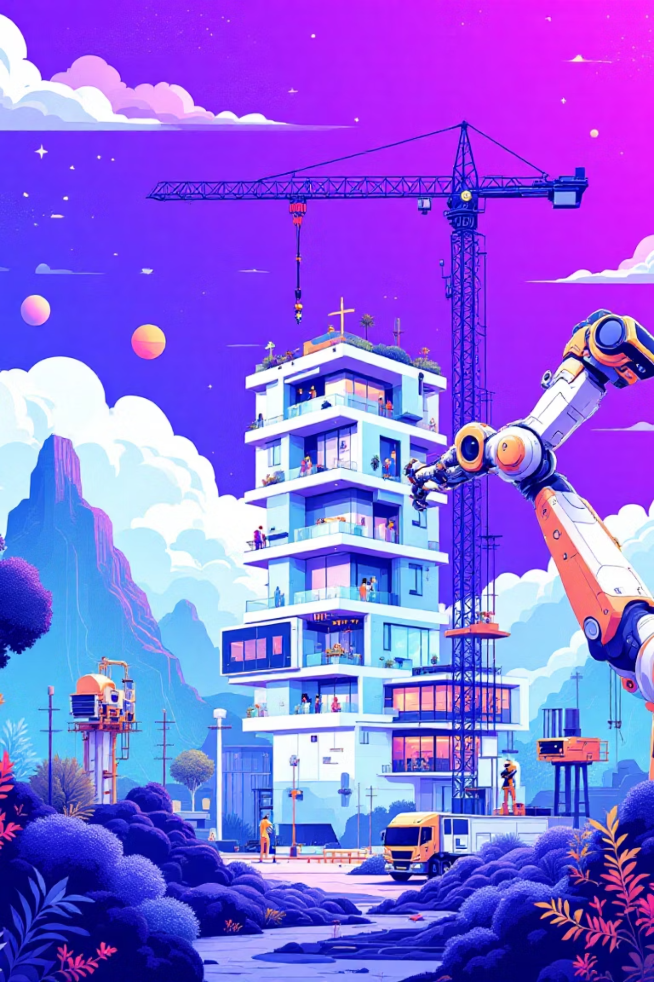
The Future is Integrated and Immersive
Our roadmap includes cutting-edge innovations to further revolutionize construction technology.
1
Q1: IoT Integration
Real-time sensor data feeds for live Digital Twin updates and monitoring.
2
Q2: AR/VR Integration
Immersive project walk-throughs and virtual collaboration environments.
3
Q3: Sustainability Scoring
Environmental impact tracking and eco-friendly construction recommendations.
4
Q4: Global Marketplace
Platform connecting architects, builders, and clients worldwide.

Slide 11

Join Us in Revolutionizing Construction
This tool makes construction smarter, faster, and cheaper
The Ask
Partner with us to scale this solution and transform the $1.6 trillion construction industry.
By leveraging AI, BIM, and Digital Twins, we're transforming how the world builds infrastructure for the future.
Ready to eliminate cost and time overruns forever?

